Slide 1
Predictive modeling of customer bookings

Slide 2
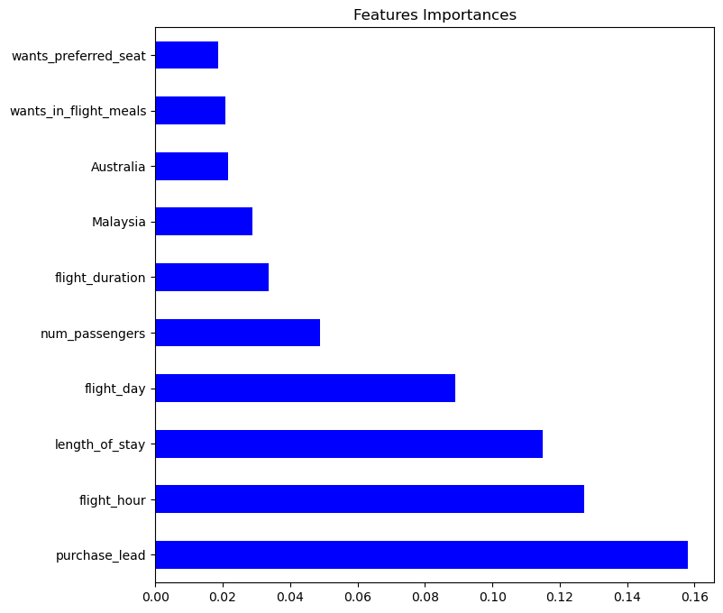
RESULTS
The top ten variables(features) that contributes towards a customer booking holiday are shown below
Accuracy and the performance of the model result.
The model accuracy result is approximately 0.856 which represent 85.6% accuracy with RMSE of 0.379(37.9%).
There are 8323 customers who completed their bookings and model predicted they are
There are 1266 customers who complete their bookings but the model predicted they are not.
There are 214 customers who not complete their bookings and the model predicted they are not.
There are 173 customers who completed their booking but the model says they did not.
RandomForestClassifier Results:
precision recall f1-score support
0 0.87 0.98 0.92 8520
1 0.55 0.14 0.23 1480
accuracy 0.86 10000
macro avg 0.71 0.56 0.57 10000
weighted avg 0.82 0.86 0.82 10000
. Purchase_lead, flight_hour, length_of_stay, flight_day, num_passengers, flight_duration, Malaysia, Australia, wants_in_flight_meals and wants_preferred_seat
Chart

